Slide 1
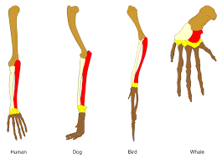
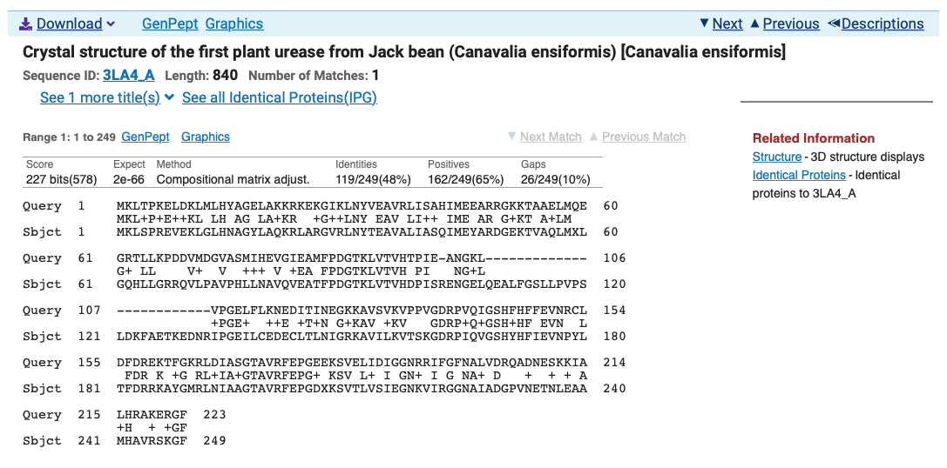
Sequence Homology
Mark Pallen

Slide 2
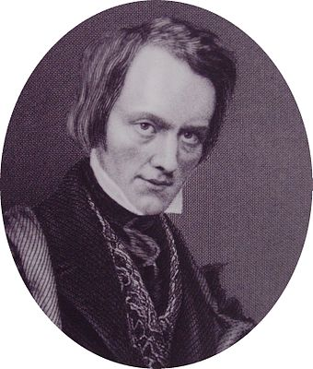
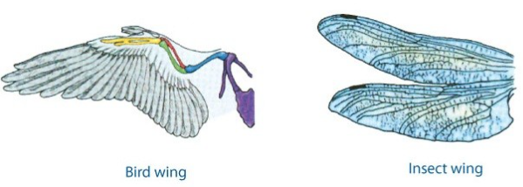
Defining homology
Term "homology" first used in biology by anatomist Richard Owen in 1843 studying vertebrate fins and limbs, defining it as "same organ in different animals under every variety of form and function”
contrasting with "analogy” to describe different structures with same function.
Owen’s criteria for determining homology:
position, development, composition.
homologous organs not necessarily similar (at least similarity may not be obvious)
similar organs are not necessarily homologous

Slide 3
Sequence homology
Languages and informational macromolecules consist of sequences of characters that show “descent with modification”
Similarity due to descent from common ancestor (homology) can be used to infer function or meaning
one, two, three
eins, zwei, drei
un, deux, troi
uno, dos, tres
Hittite (20-13th C BCE)
nu NINDA-n ezzateni watar-ma ekutteni
nu BREAD-n ezzateni watar-ma ekutteni
Now you will eat BREAD,
And you will drink water
Hrozný, Bedřich (1917)
Notes:
12

Slide 4
Sequence alignment and homology
Easy if have exact match
...but sequences diverge over time
Need alignment and search methods that allow for variability
Gap penalties
Substitution scores
ATCGATCGGGCT
||||||||||||
ATCGATCGGGCT
TDAAINPGNSG
|||||||||||
TDAAINPGNSG
ATCGATCGGGCT
||| ||||||||
ATCCATCGGGCT
TDAAINPGNSG
|||:|||||||
TDASINPGNSG
ATCG-ATCGGGCT
||| |||||||
ATCCAATCGGGCT
TDA-------AINPGNSG
||| |:||
TGGvspyadpNTCRGDSG
TTTTTTT------
-------GGGGGG

Slide 5
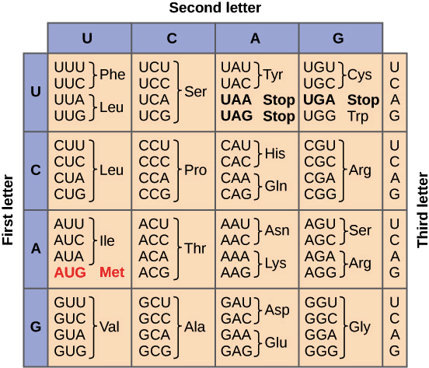
Sequence alignment and homology
Amino acid sequences more highly conserved than nucleotide
SER LEU GLY PRO
TCT CTA GGG CCC
|| || || ||
TCG CTT GGC CCG
4/4 Identical amino acids
8/12 nt matches
SER LEU GLY PRO
TCT CTA GGG CCC
| || ||
AGT TTG GGC CCG
4/4 Identical amino acids
5/12 nt matches

Slide 6
Homology vs. Similarity
Presence of similar features because of common decent
Cannot be observed since the ancestors are not anymore
Is inferred as a conclusion based on ‘similarity’
Some authorities claim homology is like pregnancy: either one is or one isn’t! (Gribskov – 1999)
Quantifies a ‘likeness’
Uses statistics to determine ‘significance’ of a similarity
Statistically significant similar sequences are considered ‘homologous’

Slide 7
Homology Searches
The aim of homology searches is to identify sequences within these databases that are homologous to your sequence.
This involves comparing your sequence with all the database sequences, looking for stretches of sequence that appear to be similar, then scoring the matches and ranking them. Usually a measure of the significance of the match will be given
BLASTN
Nucleotide query versus nucleotide database
BLASTP
protein query versus protein database
BLASTX
automatic 6-frame translation of nucleotide query versus protein database
TBLASTN
protein query versus automatic 6-frame translation of nucleotide database
TBLASTX
automatic 6-frame translation of nucleotide query versus automatic 6-frame translation of nucleotide database

Slide 8
Evidence for homology
similarity extends over a long stretch of sequence and is statistically significant by criteria known to be reliable (e.g. BLAST e values)
if sequence similarity is low, same pattern of identical or similar amino acid residues seen in multiple sequences
pattern of sequence similarity reflects the similarity between experimentally determined structures of the respective proteins or at least corresponds to the known key elements of one such structure
conserved stretches suggest important functions

Slide 9
Evidence for homology
not just interested in score for an alignment...
...but how likely we are to get that alignment by chance alone
it is this ‘non-random’ alignment that implies homology
Statistics are used to estimate this chance
The expect value or E-value
Probability of obtaining this score by chance
Best measure of how biologically significant an alignment is
Used for ranking results by default
Karlin-Altschul statistics
Statistical theory based on the extreme value distribution of the best scores for pairs of sequences; used for E-value calculation in BLAST

Slide 10
E values
The “Expect Value” is the number of times that an alignment as good or better than that found by BLAST would be expected to occur by chance, given the size of the database searched
Low e value is evidence for homology
BLAST default of “10” is designed to ensure no biologically significant alignment missed.
But clearest homology seen when e value contains an e!
2e-19
1e-66

Slide 11
Rules of thumb for homology searches
Whenever possible, compare at the amino acid level rather than at the nucleotide level (BLASTP)‏
Then with translated DNA query sequences (BLASTX)
Search with DNA vs. DNA as the next resort (BLASTN)
And then against translated DNA database sequences (TBLASTX) as the VERY LAST RESORT!

Slide 12
Rules of thumb for homology searches
Beware of simple sequences
many proteins contain low (compositional) complexity regions where distribution of amino acids is non-random, i.e. deviates from the standard statistical model
biased amino acid composition, e.g. rich in glycine or proline, or in acidic or basic amino acid residues; homopolymers
low-complexity sequences with amino acid periodicity, e.g. in coiled-coil and other non-globular proteins (e.g. collagen or keratin)
these sequences show similarity not indicative of homology
problem addressed by using composition-based statistics
many not genuinely translated coding sequences, particularly if short

Slide 13
>EHZ2931719.1 cell division protein FtsN [Salmonella enterica]
MAQRDYVRRGQPAPSRRKKSTSRNSRKKQSNMPAVSPAMVAIAAAVLVTFIGGLYFITHHKKEESETLQN
QKVTGNGLPPKPEERWRYIKELESRQPGVRTPTEPSAGGEVMNPNQLTSEQRQLLEQMQADMRQQPTQLN
EVPWNEQTPEQRQQTLQRQRQAQQQQQQQQQQQQQQQQQQQQWAQTQPVQQPRTQPRVNEQPQTRTVQSA
PAQPARQSQPPKQTASQQPYQDLLQTPAHTSAAAPKAAPITRAPEAPKPTAEKKDERRWMVQCGSFKGAE
QAESVRAQLAFEGFDSKITTNNGWNRVVIGPVKGKENADSTINRLKMAGHTNCIRLATGG
>WP_062859611.1 VWA domain-containing protein [Vibrio parahaemolyticus]
MAEFTFLNPYWLLGLITIPFVLLINQKFRAKKSALIAPHLAKMLGKTIQSKPYFTIWGLAWAIACVALAG
PSWQSNTRPSFELSQNRMLVLDMSRSMYASDIKPNRLTQTRYKALDLLPKWKEGATGLIAYAGDAYSLSP
LTTDASTLAGIIENLSPELMPFQGSNLPAAIELALSQFSQAGANQGDIVVLADDLDDSELARSLNLVKGK
NIRVSVLAIGTANGAPIALPDGSLLKTTQGSTVVAKTHLKNLQTLANKTGGMFVPIQHNNRDVDSIAAYT
NNTGNNLAAKQNQEVKTDSRLNGGFWLLPLLLLPTVFLFRRGVIWVFFAALLPMTWTPGAQANPFLNADQ
QAANLYKQGEYEQAKNLFTDPSWQGAASYQTGDYEAAIKAFSNDPSQTGRYNLANALAQNGQLEEADKQY
KKLLKENPDFEAAKKNLSVVEEKLKQQQQQQQQQQQQQQQQQQQQQQQQQQQQQQQQQQQQQQQKSQNST
KQEQGQQSQNQQDAENKKEKQESEHKAKQQKAETEVEKQGEQKKGEPMQAQVQPEKSHQDDPEFRRLEAV
ERARDPSFLIRAQMQLQAQQKQRPQQSQKEW
>MBB5201672.1 hypothetical protein HNR39_003530, partial [Glaciimonas immobilis]
QQQQQQQQQQQQQQQQQQQQQQQQQQQQQQQRPQPR

Slide 14
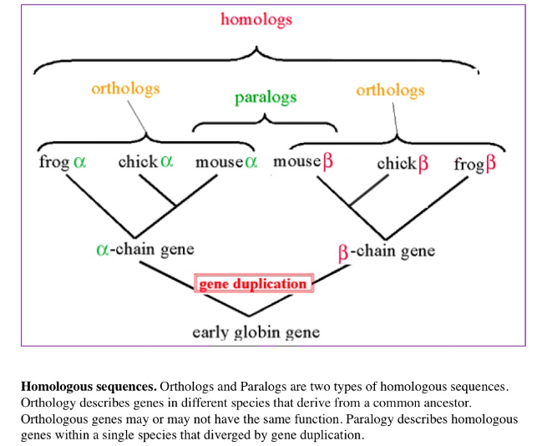
Orthology versus Paralogy
Homology can be reliably inferred from statistically significant similarity
But remember:
Orthologous sequences generally have similar functions
Paralogous sequences can acquire very different functional roles
So further work might be needed to tease out details

Slide 15
Annotation and its problems
Signal Peptide
A
Proteins consist of domains
Signal Peptide
B
Transitivity of Homology
Coiled coil domain
C
Toxin Domain
Distant Homology
D
The annotation catastrophe: all these proteins get labelled “toxin”, because they show homology to a protein containing a toxin domain, but the homology is actually in an entirely different domain!
Number of proteins annotated by homology >>> those with with experimentally verified functions
Need to chase evidence trail back to experimental or structural evidence
Notes:
14

Slide 16
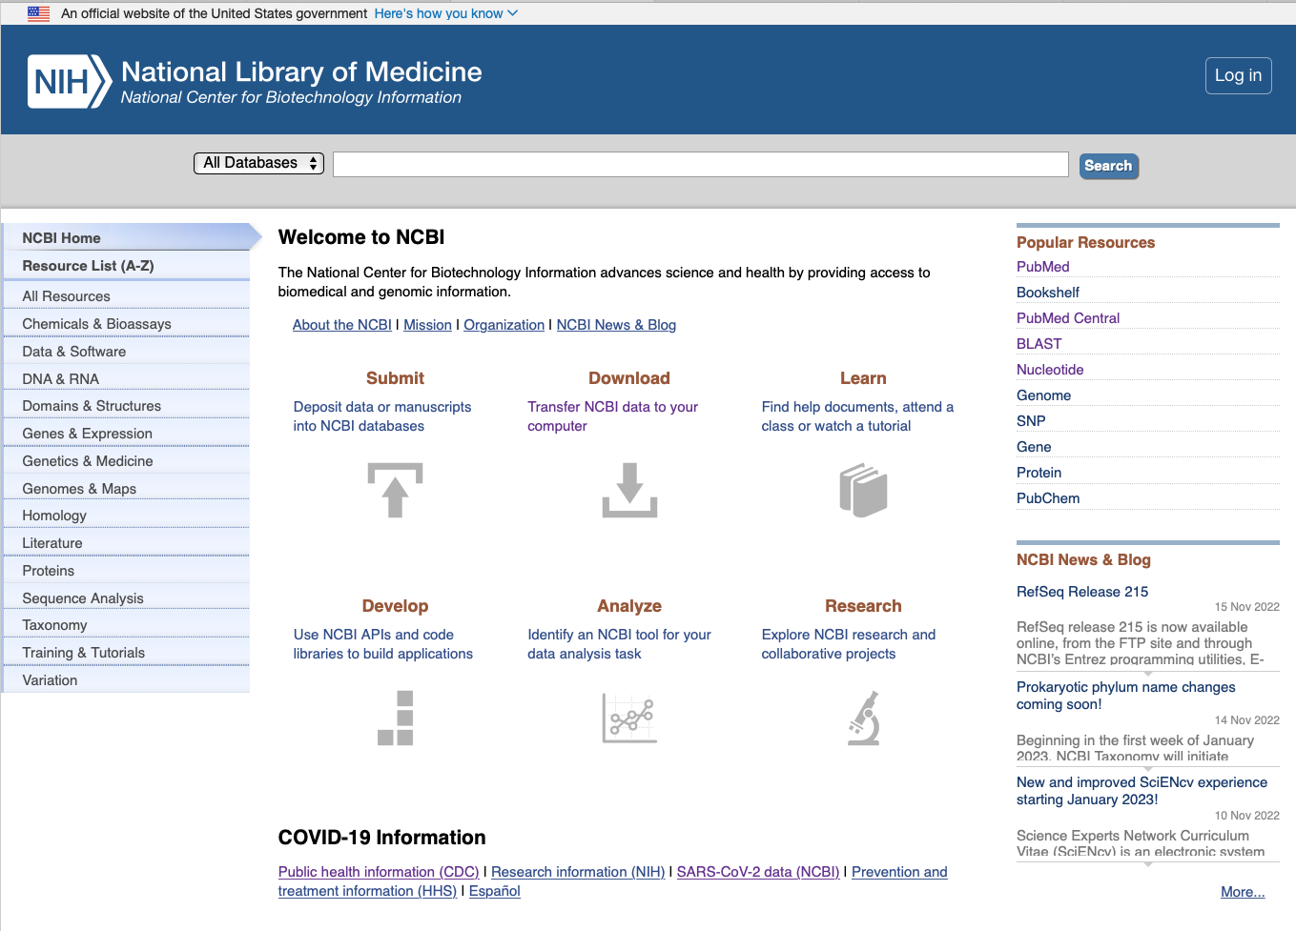
The awesome power of NCBI!
https://www.ncbi.nlm.nih.gov

Slide 17
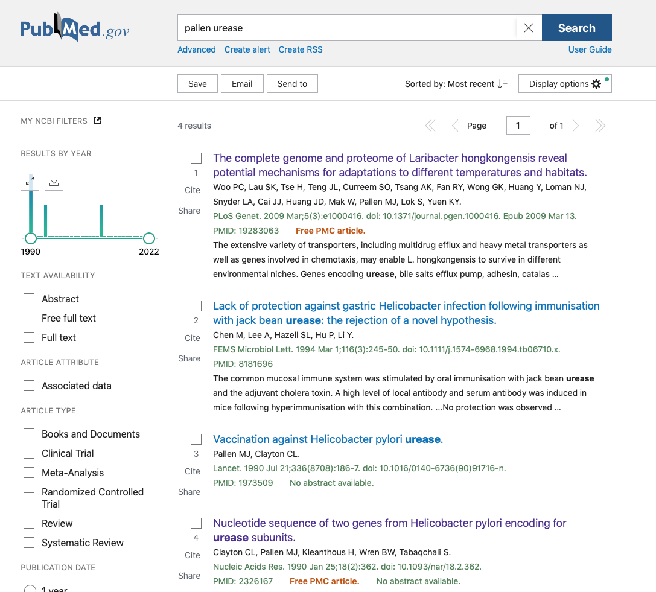
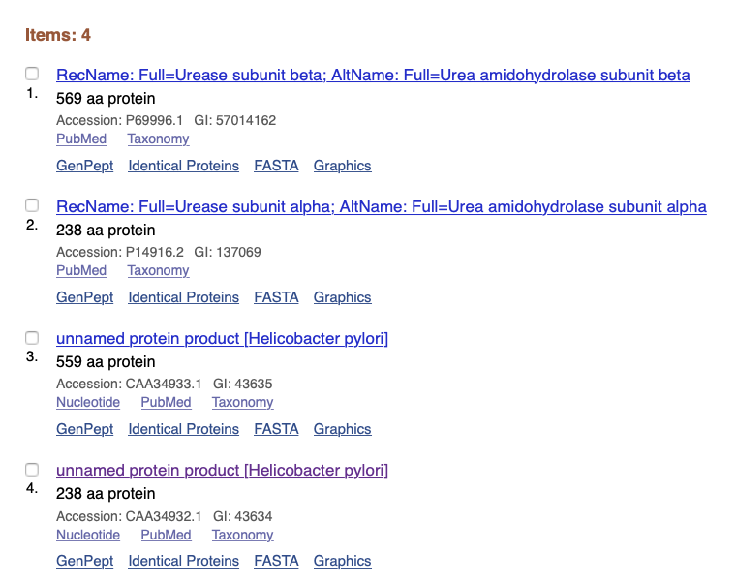

Slide 18
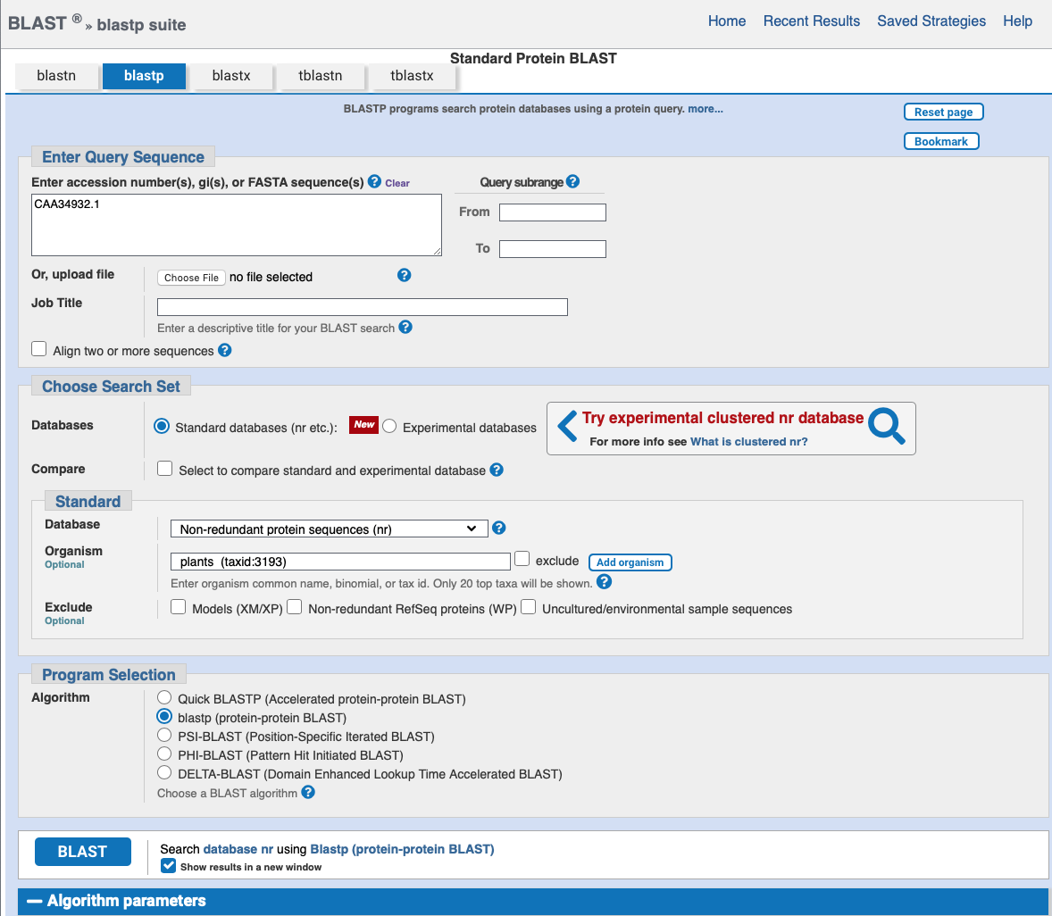
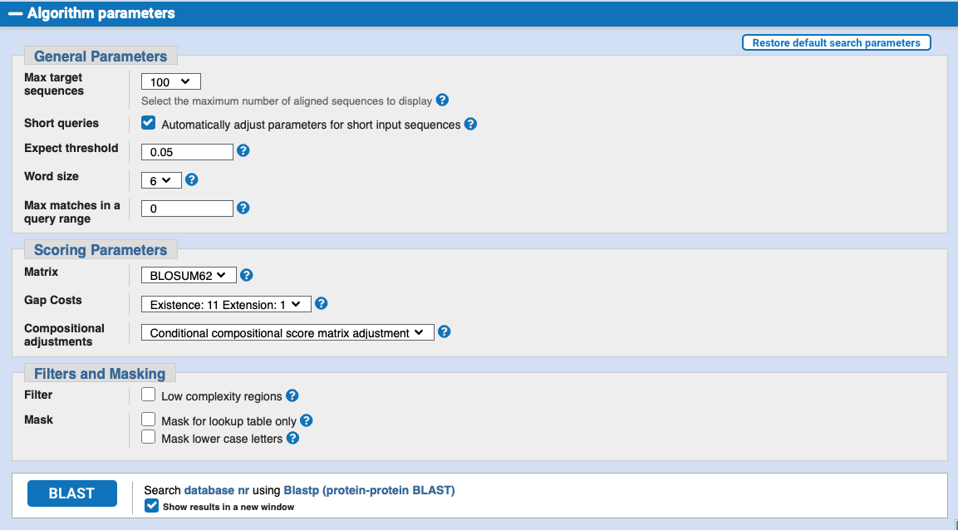

Slide 19
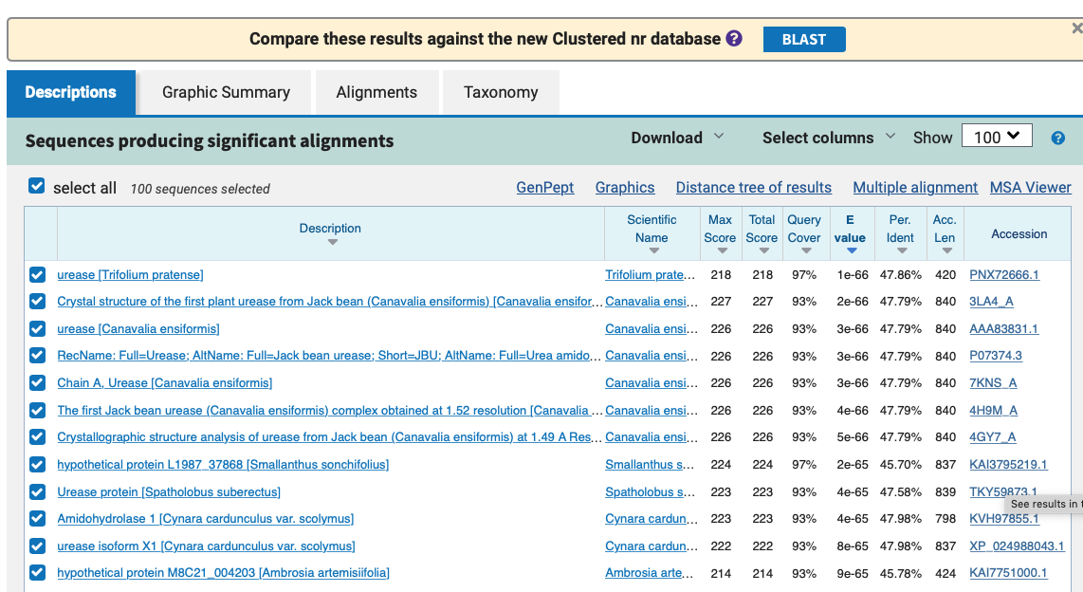

Slide 20
Further reading and acknowledgments
https://www.ncbi.nlm.nih.gov/books/NBK20260/
https://www.ncbi.nlm.nih.gov/books/NBK1734/
https://www.ncbi.nlm.nih.gov/home/tutorials/
https://www.ncbi.nlm.nih.gov/Class/BLAST/blast_course.short.html
Sequence searching and alignments - Andrew Cowley EBI
www.ebi.ac.uk/sites/ebi.ac.uk/files/content.ebi.ac.uk/materials/2012/120508_Rotterdam/sequence_searching_alignments_cowley.2012.pptx

